Slide 1
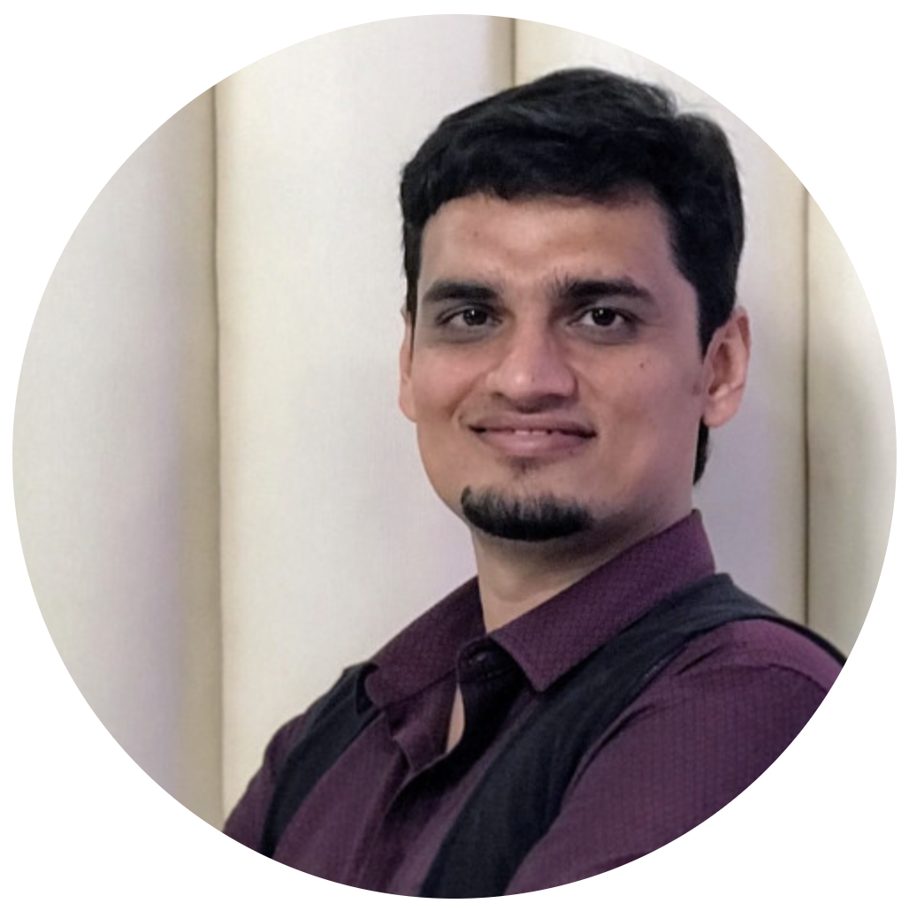

Keeping on top of Hybrid-Cloud usage with Apache Pulsar
Shivji Kumar Jha
Staff Engineer at Nutanix,
Apache Pulsar Contributor
Tarun Annapareddy
MTS-3 at Nutanix

Slide 2

Who are we?
Shivji Kumar Jha
Staff Engineer at Nutanix,
Apache Pulsar Contributor
Tarun Annapareddy
MTS-3 at Nutanix
Leading “Cloud data Platforms” Team
Loves Distributed Systems & Open-Source fanatic
Data geek(data stores, stream, analytics etc.)
Pulsar & MySQL Contributor
Loves Distributed Streaming Frameworks
Writes articles on software technologies
Apache Pulsar Enthusiast
in/tarun-annapareddy-b9835611b
in/shivjijha

Slide 3
Legal Disclaimer
Forward Looking Statements
This presentation and the accompanying oral commentary may contain express and implied forward-looking statements, including, but not limited to, statements relating to: our business plans, initiatives and objectives; our ability to execute such plans, initiatives and objectives in a timely manner, and the benefits and impact of such plans, initiatives and objectives, including our ability to manage our expenses in future periods; our financial model targets and our plans to achieve those targets; the benefits and capabilities of our platform, products, services and technology; our plans and expectations regarding new products, services, product features and technology, including those that are still under development or in process; the timing of any product releases or upgrades or announcements; anticipated trends, growth rates and challenges in our business and in the markets in which we operate; our ability to develop new solutions, product features and technology and bring them to market in a timely manner, as well as the impact and/or benefits of including additional solutions or features in our product portfolio; market acceptance of new technology and recently introduced solutions; the interoperability and availability of our solutions with and on third-party platforms, including public cloud platforms; our ability to maintain and strengthen our relationships with our channel partners, OEMs and other third parties, and the impact of any changes to such relationships on our business, operations and financial results; the competitive market, including our competitive position and ability to compete effectively, our projections about our market share in future periods, the competitiveness of our future cost structure with those of other companies, and the competitive advantages of our products; our plans and timing for, and the success and impact of, our transition to a subscription-based business model; and macroeconomic trends and geopolitical environment, including the on-going global supply chain disruptions.
These forward-looking statements are not historical facts and instead are based on our current expectations, estimates, opinions, and beliefs. Forward-looking statements should not be considered as guarantees or predictions of future events. Consequently, you should not rely on these forward-looking statements. The accuracy of these forward-looking statements depends upon future events and involves risks, uncertainties, and other factors, including factors that may be beyond our control, that may cause these statements to be inaccurate and cause our actual results, performance or achievements to differ materially and adversely from those anticipated or implied by such statements, including, among others, the risks detailed in our most recent Annual Report on Form 10-K and Quarterly Reports on Form 10-Q, each as filed with the U.S. Securities and Exchange Commission, or the SEC, which should be read in conjunction with the information in this presentation and accompanying oral commentary. Our SEC filings are available on the Investor Relations section of our website at ir.nutanix.com and on the SEC's website at www.sec.gov. These forward-looking statements speak only as of the date of this presentation and accompanying oral commentary and, except as required by law, we assume no obligation, and expressly disclaim any obligation, to update, alter or otherwise revise any of these forward-looking statements to reflect actual results or subsequent events or circumstances.
Product or Roadmap Information
Any future product or roadmap information included in this presentation and the accompanying oral commentary is (i) intended to outline general product directions, (ii) not a commitment, promise or legal obligation for Nutanix to deliver any material, code, or functionality, and (iii) not intended to be, and shall not be deemed to be, incorporated into any contract. This information should not be used when making a purchasing decision. Further, note that Nutanix has made no determination as to whether separate fees will be charged for any future products, product enhancements and/or functionality which may ultimately be made available. Nutanix may, in its own discretion, choose to charge separate fees for the delivery of any future products, product enhancements and/or functionality which are ultimately made available.
Third Party Reports and Publications
Certain information contained in the presentation and accompanying oral commentary made available as part of this digital event may relate to or be based on reports, studies, publications, surveys and other data obtained from third-party sources and our own internal estimates and research. While we believe these third-party reports, studies, publications, surveys and other data are reliable as of the date of the applicable presentation, they have not independently verified, and we make no representation as to the adequacy, fairness, accuracy, or completeness of any information obtained from third-party sources.
Trademark Disclaimer
© 2022 Nutanix, Inc. All rights reserved. Nutanix, the Nutanix logo, and all Nutanix product, feature, and service names mentioned herein are registered trademarks or trademarks of Nutanix, Inc. in the United States and other countries. Other brand names or logos mentioned or used herein are for identification purposes only and may be the trademarks of their respective holder(s). Nutanix may not be associated with, or be sponsored or endorsed by, any such holder(s).

Slide 4







What do we do?
Nutanix unifies public cloud simplicity with private cloud performance and security
Whether on-premises or hybrid, we’ll ensure business continuity through centralized management, one-click operations
More than 20,000 leading companies trust Nutanix
Supported Clouds
https://www.nutanix.com/

Slide 5
Agenda
Need for Hybrid-Cloud and Multi-Cloud
Challenges with Multi-Cloud and Need for Single plane of view
Architecture overview
Apache Flink-Pulsar Connector
Key Features of Apache Pulsar
Challenges we faced in the production

Slide 6

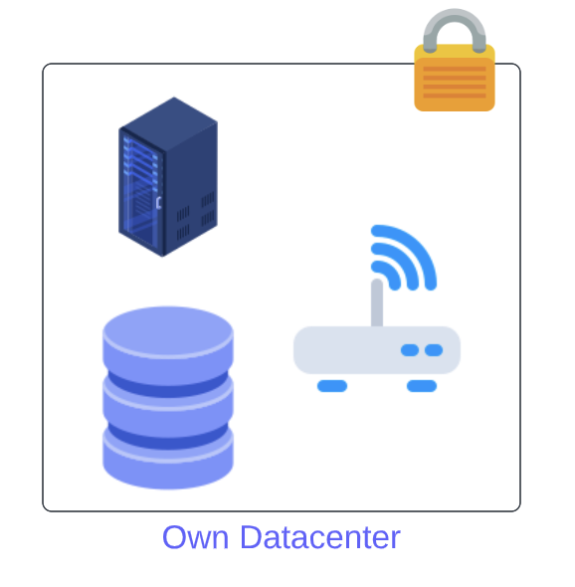

On-Premises Infrastructure
More control over the resources
Predictable Server usage
Reduced costs
Data Security

Slide 7
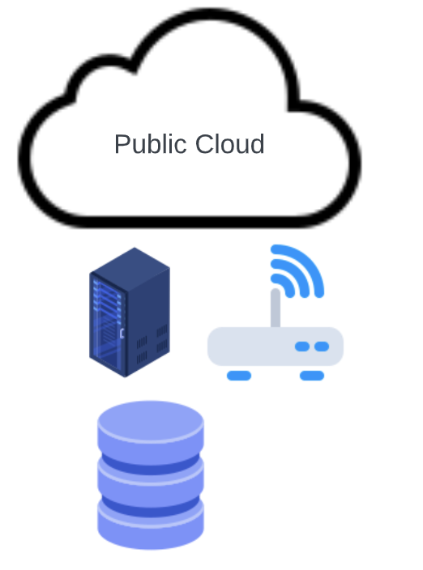
Public Cloud
Fast and easy Infrastructure setup
Pay-As-You-Go Model
Rent Servers

Slide 8
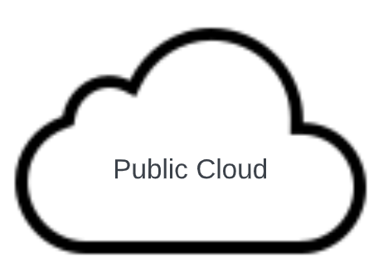
Hybrid Cloud : Cloud Bursting
Cloud Bursting

Slide 9
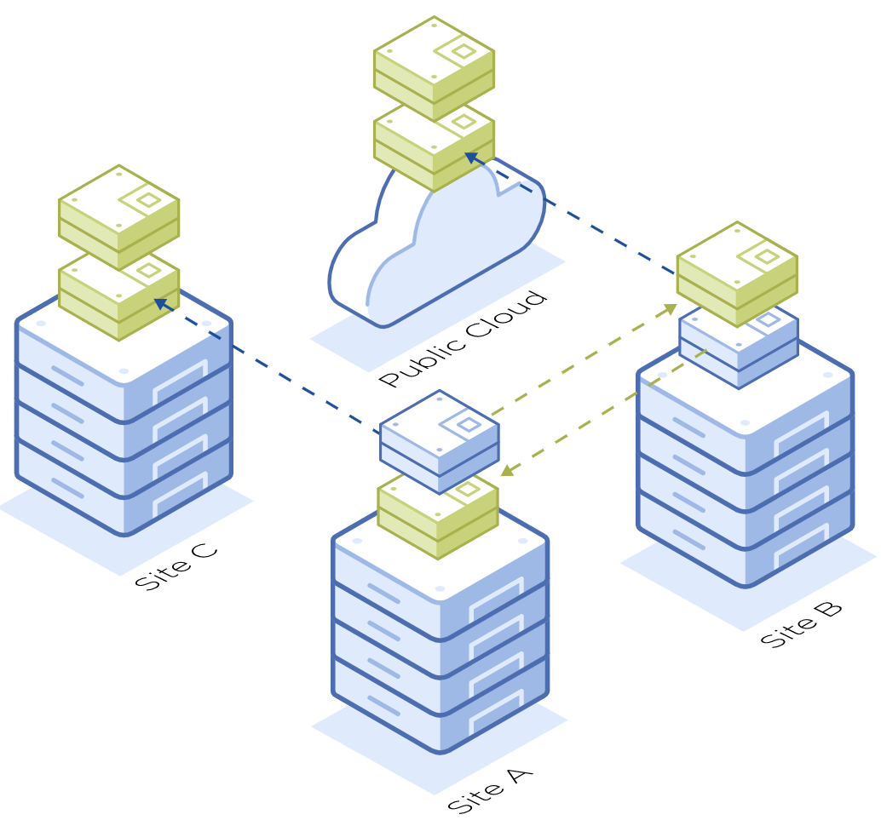
Hybrid Cloud : Nutanix Disaster Recovery
More distributed means more available in the event of a disaster
Make Replication and Disaster Recovery Effortless Across Multiple Sites
Single click Failover
Automated recovery plans
https://www.nutanix.com/products/nutanix-cloud-infrastructure/disaster-recovery

Slide 10






Multi-Cloud : Choose the best features
Best for Web Applications
Best for big data analytics
Best for Microsoft Products
https://bit.ly/2W9UEq6

Slide 11
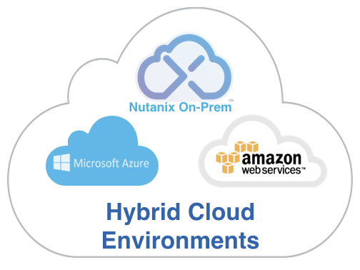





Need for a Single plane of view
Lack of Unified Visibility Across Cloud Boundaries
Infrastructure
Complexity
Complicated Compliance Auditing
Skill Gap
https://portal.nutanix.com/page/documents/solutions/list
Notes:
But just like there are no free lunches in the world, a hybrid-cloud security strategy doesn’t come without its challenges. The biggest one is that of lack of unified visibility across all your cloud environments. Your applications may not be running in a single cloud environment. Therefore, your security operations solutions should provide you a single pane of glass to monitor security for both public and private cloud deployments. Ensuring continuous protection against data leaks and breaches is not easy. Another big challenge in hybrid multi-cloud environments is Infrastructure Complexity across cloud boundaries. You should be able to establish and manage security rules for multiple environments. It becomes difficult to track and monitor your compliance status as each cloud environment is different. You also need to worry about the misconfigurations caused by human errors. You would want to catch those instantly to ensure that the resultant vulnerabilities aren’t left open to be exploited. To add to that you need a varied set of skills required within your teams to ensure effective security and compliance.

Slide 12
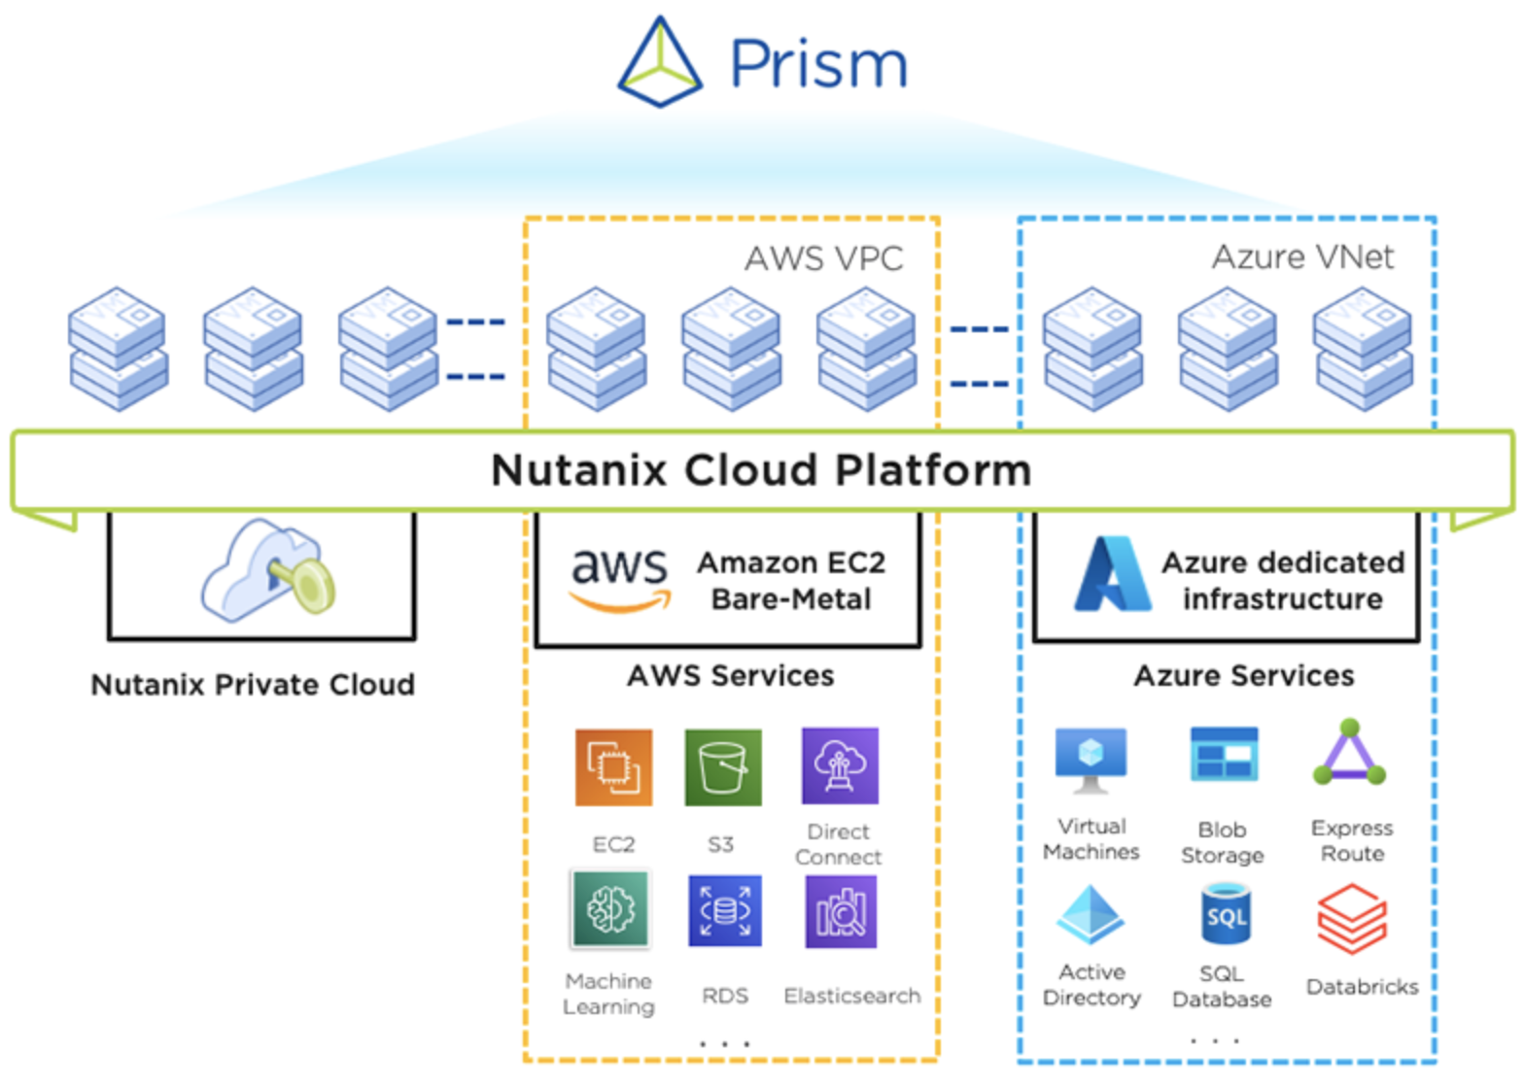
Nutanix Cloud Clusters
All your Clusters, On-Premises and Public can be operated as a single cloud
Seamless Application movement without any code changes
OnDemand capacity bursting
Disaster recovery
https://www.nutanix.com/products/nutanix-cloud-clusters

Slide 13

Proposed Architecture
Notes:
As Apache Pulsar and Flink constitute to the heart of our architecture, In the next few slides,
I will introduce Apache Flink, and take a deep dive into the Flink- Pulsar interactions in our architecture.
I will also cover, Features of Pulsar that we take advantage in our design and
some challenges, we faced with Flink-Pulsar system as a whole in our production.

Slide 14
Lambda Architecture
Unites the benefits of the batch and stream processing techniques.
Serve a wide range of use cases and withstands faults well with
Batch Layer
High Precision (involved algorithms?)
Latency not a concern
Think Hadoop!
Speed Layer
Trades precision for low latency and high availability
Think (Pulsar / Kafka) + (Flink / Spark)
https://www.researchgate.net/publication/338375917_Lambda_Architecture_-_Realtime_Data_Processing

Slide 15
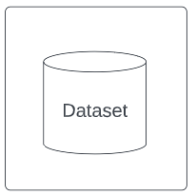
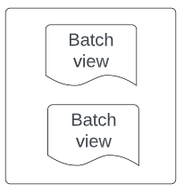
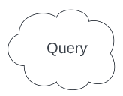
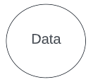
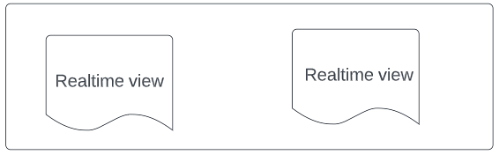
Lambda Architecture
Batch Layer
Service Layer
Speed Layer
https://www.researchgate.net/publication/338375917_Lambda_Architecture_-_Realtime_Data_Processing

Slide 16

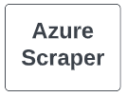
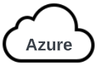



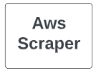


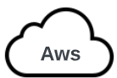



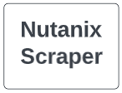
Batch+ Stream Processing
Query Layer
Batch & Stream Layer
Nutanix
Data Layer
Inventory: EC2/S3/Blob

Slide 17

Batch+ Stream Processing
Inventory
Inventory
Inventory
Inventory
Inventory
Inventory
Inventory
Nutanix
Inventory: EC2/S3/Blob

Slide 18

Batch+ Stream Processing
Events
Events
Inventory
Inventory
Inventory
Inventory
Inventory
Nutanix
Inventory: EC2/S3/Blob

Slide 19

Batch+ Stream Processing
Events
Events
Events
Events
Inventory
Inventory
Inventory
Nutanix
Inventory: EC2/S3/Blob

Slide 20

Batch+ Stream Processing
Events
Events
Events
Events
Events
Events
Events
Nutanix
Inventory: EC2/S3/Blob

Slide 21
Apache Pulsar + Flink: The path to Unified batch and stream processing
Notes:
As Apache Pulsar and Flink constitute to the heart of our architecture, In the next few slides,
I will introduce Apache Flink, and take a deep dive into the Flink- Pulsar interactions in our architecture.
I will also cover, Features of Pulsar that we take advantage in our design and
some challenges, we faced with Flink-Pulsar system as a whole in our production.

Slide 22
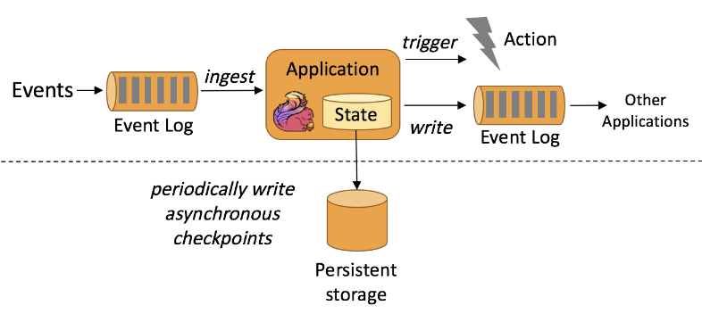
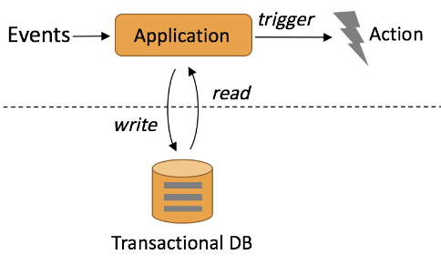
Stream Processing - Apache Flink
Stream-based distributed processing framework
Optimized In-Memory state access for event-driven applications
Very Suitable for Extract-Transform-Load(ETL) applications
https://nightlies.apache.org/flink/flink-docs-master/docs/concepts/stateful-stream-processing/
Notes:
Flink is a true Stream-based distributed processing engine from its core design, unlike other systems like Spark. Also, Flink uses the same abstraction for batch processing, which makes it a unified batch& Stream processing engine.
Unlike Traditional event-driven systems, which separate computing and storage, Flink uses the local state for all its computations, which yields low processing latencies. Also, it periodically persists these states for fault tolerance
Therefore, Flink is especially suitable for ETL jobs, where they can consume the events from sources like Apache Pulsar, enrich the data and trigger events or sink to Pulsar for further processing.

Slide 23
Flink-Pulsar Connector
PulsarSource<String> source = PulsarSource.builder()
.setServiceUrl(serviceUrl)
.setStartCursor(StartCursor.earliest())
.setTopics("my-topic")
.setSubscriptionName("my-subscription")
.setSubscriptionType(SubscriptionType.Exclusive)
.build();
// topics “my-topic-1”, “my-topic-2”
PulsarSource.builder().setTopics("my-topic-1", "my-topic-2");
// Partition 0 and 2 of topic “my-topic”
PulsarSource.builder().setTopics("my-topic-partition-1", "my-topic-partition-2");
// all partitions of topic “my-topic”
PulsarSource.builder().setTopicPattern("my-topic-*");
// Struct types (JSON, Protobuf, Avro, etc.)
PulsarDeserializationSchema.pulsarSchema(Schema, Class);
Notes:
The Flink-Pulsar connector allows Flink to analyze data from the pulsar and write data to the pulsar.
Creating a pulsar source for consuming messages is simple by using the Pulsarsource builder
You have to provide the service URL pointing to the broker cluster
Also, you can use cursors to set the starting position in the pulsar queue, either from the earliest or oldest message or even from specific messageId
And provide the pulsar topic from which you want to consume messages
And subscription name for your consumer group,
And subscription Mode, Pulsar support four subscription modes: Exclusive, Failover, Shared, and key-shared, which cover various use cases. This source builder gives the flexibility to pick the right choice based on your needs.
Also, you can set the pulsar-source to consume from multiple pulsar topics, or specific partitions, from the same topic, or you can even use a regular expression to match topic names
Also, you can use deserialization to decode bytes into the Avro schema class objects. This can help in achieving clean code too

Slide 24
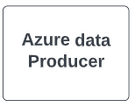
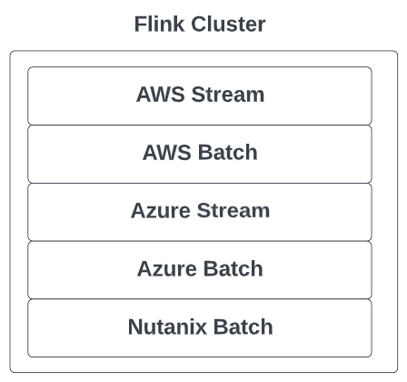
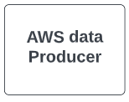
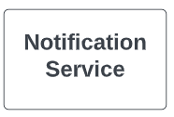
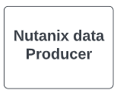




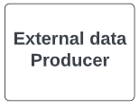


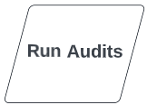
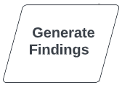
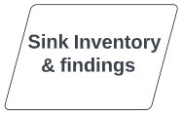
Flink-Pulsar view of Architecture
Inventory: EC2
Event : Update Virtual Machine
Notes:
Now, we will take a re-look at our architecture that we have discussed before from the Flink-Pulsar connector perspective.
We have multiple data producers, which produce either inventory/ events to Pulsar, from various clouds like Azure, Aws and Nutanix, also we can have external connector for third party events. Event can be as simple as a log Update Virtual Machine collected from the Aws log trails. And Inventory is that specific EC2 instance.
We have multiple jobs in our flink cluster which consume the data from the pulsar queue.
One sample Job graph looks like this. First, enrich the event and find the specific inventory connected to it, then run Audits on top of it, sample audits can be “is Azure disk encrypted?” or “does AWS EC2 instance has public ip Assignment?”. Then we generate findings from the Audits and store both the inventory and findings to databases.
We initially started with Relational database like postgres, but, later we realised that there is a relation between the inventory. For examples customers are interested in queries like “find VMs which uses unencrypted disks” or “find all policies enforced on a VM”. So we developed Custom query language which runs queries on top of Neo4j.
We also publish our findings to pulsar so that, the notifications service can notify consumer if they have configured rules for Notifications through e-mail, splunk or webhooks

Slide 25
Key Features of Apache Pulsar
Partitioned Topics : Scale beyond single broker
Unified Messaging Model : Streaming and Queuing
Pulsar Schema : Built-in Schema Management
Multi Tenancy: Isolation, Policies
Features of Flink-Pulsar connector
Notes:
We utilize numerous features of Apache pulsar at Nutanix. I have listed down a few key ones here.
Partitioned topics. We know in pulsar, each topic can be managed only by one broker. But at the scale we operate, we need more throughput. The partitioned topics comes in handy in this case. I will explain this in detail in later slides.
Unified Streaming and queuing model. Many queuing systems like Rabbit MQ. and Streaming systems Apache Kafka are available. But Pulsar, the unified Streaming and queuing system, helps our company develop products based on one underlying system. I will also discuss this in detail in later slides
Pulsar Schema. The built-in schema management enables message producers and consumers on Pulsar topics to coordinate the structure of the topic’s data through the Pulsar broker itself without needing some kind of external coordination mechanism
Multi-Tenancy, In pulsar, all the topics are stored in a hierarchical namespace. So, we have tenant, namespace and then topics. This will allows us to enforce policies based control at various levels, like how much storage we want to allocate to a namespace and time to live etc.,
The rich feature set of the Flink-Pulsar Connector, which we have already explored

Slide 26
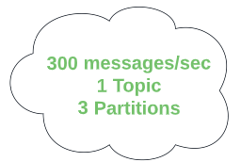


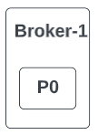

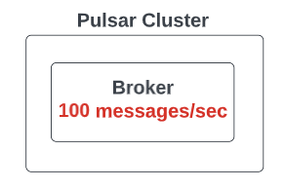
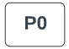
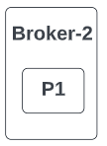
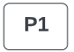
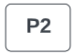
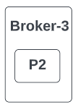


Partitioned Topics
Ordering?
Notes:
Consider we have a producer, which can produce at the rate of 300 messages per second to a topic. But our pulsar broker is sized to receive only 100 messages per second. As we know one topic can only be handled by one Broker. So, with this configuration you get log of backlog, unstability and backpressure. Also, you cannot scale the brokers horizontally beyond a limit.
Thats when we can use partitioning, where, you can map the data to multiple partitions and if each broker can handle one partition, then you can achieve the scale of 300 messages per second you need with 3 brokers. By using round robin strategy we can split the load equally for each partition.
Ahaa, we did it !!! but, there is a trade off here. With partitioning we loose the ordering of data across the partitions. In our usecase at nutanix, we need ordering of data at customer level, So we hash based on customerId, Which will not produce equal split per broker but can still help us to achieve the scale. Also, we configured each broker to handle multiple partitions, as the number of partitions in our case is way beyond the brokers.

Slide 27
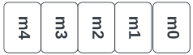

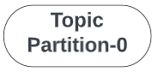
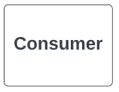

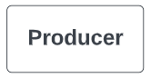


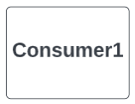

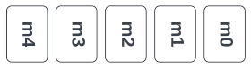
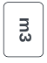
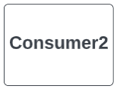

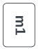

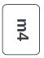
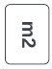
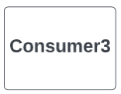
Unified Streaming and Queuing model
Notes:
Unified Messaging model, you just store one copy of data in pulsar and provide multiple ways of consuming the data through different subscription types. So it is like a combination of RabitMQ-type queuing and Kafka-style streaming.
Suppose a producer is producing events to multiple partitions, and we will pick one partition to discuss. We have a consumer group that needs to process data in an ordered style. They can use the Subscription type Exclusive. Also, we have a consumer group with many ML workers who do not need ordering in the data. They can use the subscription type Shared and get better throughput.

Slide 28
Challenges we faced in Production
Exactly-Once Processing with Flink-Pulsar Connector
Acknowledgement strategy with Flink-Pulsar Connector
Open-source contributions to add security to Flink-Pulsar connector
Open-source contributions to Pulsar Server to run with schemas
Notes:
Exactly once processing guarantee is not easy to achieve, let us discuss how we achieved it with Flink-Pulsar Connector.
Inefficient Flink- Pulsar acknowledgment strategy in older versions affected our throughput. We will discuss how that was improved with time.

Slide 29

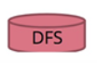
Exactly-Once Processing
Never loose your events with Checkpoints
Exactly Once End-to-End Processing??
Transactional Sinks
Idempotent system
Checkpoint Barrier Alignment
k
7
6
5
4
3
2
1
Acknowledge
Persist Local State
Notes:
With Checkpointing, you will never loose events. But achieving Exactly-Once end to end guarantee is challenging. You should use transactional sinks to make sure that events are actually saved before acknowledgement. And let us suppose message 5 is processed and stored in database before crash, but when flink restarts pulsar retreis message5. So, you need idompotent system. Also, if you are using complex join operation from multiple input streams, you need to do checkpoint barrier alignment to avoid re-processing the events that fall between 2 checkpoints. This will increase backpressure on your system. Which these tradeoffs you can achieve exactly-once end to end guarantee.

Slide 30
Improved Flink-Pulsar Connector
Flink 1.8 + Pulsar-Flink Connector 2.6.1
Acknowledge Async
ArrayDeque<Tuple2<checkPointId, Set<MessageId>>> pendingCheckpoints;
// end of kth checkPoint
Tuple2<k,Set<1,2,3,4>> checkpoint
for (MessageId id : checkpoint.f1) { consumer.acknowledgeAsync(id); }
Flink 1.15 + flink-connector-pulsar 1.16.0
Cumulative Acknowledgement
SortedMap<checkPointId, Map<TopicPartition, MessageId>> cursorsToCommit; Map<TopicPartition, MessageId> cursors = cursorsToCommit.get(checkpointId);
// end of kth checkPoint
<partitionId, 4> cursor cursors.forEach((partition, messageId) ->
pulsarConsumer.acknowledgeCumulative(messageId));
Notes:
Initially we started with FLink1.8, which did not provide default pulsar connector. So we used pulsar-connector 2.6.1. It used to acknowledge inefficiently for ordered sources.
While upgrading flink to 1.15, we came across flink connector pulsar 1.16, which uses cumulative ack.
Which cumulative ack, we have observed reduction in checkpoint time.

Slide 31




@shivjiJha
in/tarun-annapareddy-b9835611b
tarunannapareddy1997
in/shivjijha
shiv4289
shiv4289
Shivji Kumar Jha
Tarun Annapareddy

Slide 32
Exactly-Once Processing with Flink-Pulsar Connector
5
4
3
1
Ack
Transactional Sinks
Idempotent system
Checkpoint Barrier Alignment
At Most Once Processing
Exactly Once End-to-End Processing

Slide 33
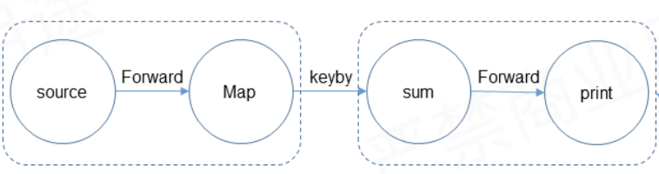

Word Count with Apache Flink- Pulsar
env. addSource(pulsarSource)
. map(word-> new Tuple2(word,1))
. keyBy(r-> r.f0)
. sum(1)
. print()
Operator Parallelism
Network Shuffle
Operator Chaining
In memory Map/ RocksDB
https://community.alibabacloud.com/series/116
Notes:
Given that we understood the Flink-Pulsar Connector, let us look at one example of word count with Flink, where your pulsar source contains a set of words in a book, and we want to find the frequency of those words
First, you must create a Flink Environment and add the pulsar source we created before
Map each word to a tuple of word and 1, which can be used later to track count
Now key by the word so that same words can be moved to a single operator to find the count. Remember, we are using stateful operators, So each keyed data has to move to the corresponding operator before computation.
Once the operator has the event, increment the count stored in the state map for the word.
May be based on time-based watermarks or events. You can trigger the state maps to close the computations and print the data.
So, Flink job graph looks like this, Your Source forward the data to Map operator which does keyBy word before transferring to the Sum Operator wich them compute the sum and forward to Print.
If we look indepth, the actual execution graph for this job looks like this.
You can define operator parallelism, In this case may be Sum operator is expensive so you can give it more praallelism compared to others
Every time we use keyBy, the data have to be shuffled to the right operator, flink does this for us
Also, Flink used operator chaining for minimising the expensive network shuffle by combining the operators with forward edges.
And at last, Inmemory statemaps optimise the computations of sum operator

